Slide 1
Tutorial hints
Some of you are not making the most of the lecture notes
We (usually) won’t ask you to do things that haven’t already been discussed, so …
If you have a tutorial task that you are not sure how to do ... try to find a similar example in the lecture notes

Slide 2
Tutorial hints (2)
Read the question carefully!!!!!!
make sure you are doing what you are being asked to do
Some problems are to do with getting the syntax exactly right
for example, don’t forget the colon “:” at the end of each if / elif / else statement
Also you need to start thinking like a programmer

Slide 3
Thinking like a programmer
Is your solution concise & readable
how do you tell?
Conciseness:
is there any duplication in your program?
Readability:
can you easily tell from the variable names what is going on?

Slide 4
Question 2
In question 2 the program:
asks the user for some input (their name)
uses the input to construct the output (“Hello [name]”)
adds an additional piece of output in one particular case (for one particular name)
There are lots of ways to do even a very short program like this
there are 3 examples in the solutions

Slide 5
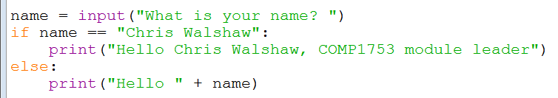
02aHelloName
What are the problems?
The duplication is only minor, but try to avoid
Also there is no real need for an else statement
because in all cases we print “Hello [name]”
duplication
duplication
duplication
duplication

Slide 6
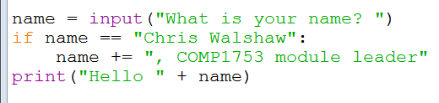
02bHelloName
The next version is better (no duplication, no else statement) …
... but the variable name is misleading
now name contains both a name and a job description

Slide 7
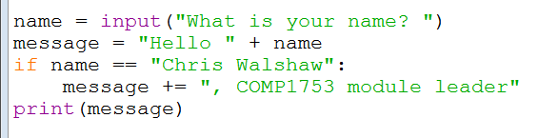
02cHelloName
The final version is both concise and readable
not as concise as version (b), but clearer

Slide 8
Tutorial Hints (3)
Think in Python, not in English
In English we say “if age is below 18 or above 65”
But in Python we can’t say
if age < 18 or > 65
because “or” is an operator which combines two conditions and “> 65” is not a condition
Have to say
if age < 18 or age > 65

Slide 9
Tutorial Hints (4)
Even if you do question 7 (triangle / square) correctly, it won’t work in IDLE
IDLE grabs the focus when you type in what shape you want
so the Turtle window pops up behind the IDLE window
I don’t know of a work around for this
but it works fine if you double-click the .py file

Slide 10
Functions
Chris Walshaw
Computing & Information Systems
University of Greenwich

Slide 11
Lecture Objectives
This week we shall look at functions
declaring
invoking
arguments
parameters
Things can sometimes go wrong when you implement functions
so we shall consider several examples

Slide 12
Motivation
Looking back at previous examples our code can be a bit hard to read
too much detail
duplicated operations
Functions are a way of eliminating these issues
in other languages they are sometimes called methods or subroutines

Slide 13
Functions
A Python function is a block of code designed to perform a particular task
A Python function is executed when "something" invokes it (calls it)
Can you think of any examples from the previous lectures?
In fact we have used several functions:
print(), input(), int(), str(), randint(), all the turtle commands, …
What do they have in common?
answer: round brackets
https://www.w3schools.com/python/python_functions.asp

Slide 14
Writing functions
The functions we have used so far are all provided as part of the Python language
print(), input(), int(), str(), randint(), …
sometimes know as built-in functions or library functions
However it is easy to write our own functions
We shall do this to simplify some of the previous examples
first we will look at a motivating example

Slide 15
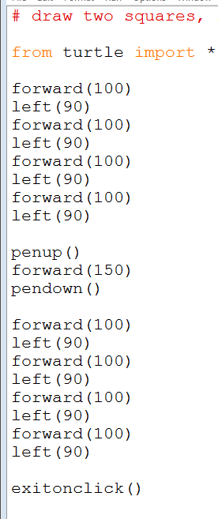
Motivating example
In the Tutorial 1 solutions is a program which draws two squares using duplicated code
this code draws a square …
so does this code …
they are exactly the same and each takes 8 lines of code
what if we want 100 squares (e.g. for a game)? does that mean we need 800 lines of code?

Slide 16
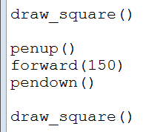
01Turtle_squares
Instead we can put the details of how to draw a square in a function called draw_square()
Now the main part of our program is just
For the rest of the lecture we will write functions to improve the Calculator examples
much simpler and easier to understand!

Slide 17
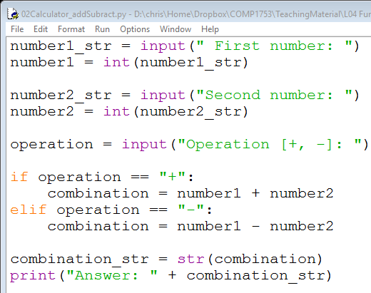
02Calculator_addSubtract
Example 02 is fairly straightforward …
… but not as simple as it could be
this version of the calculator just does add & subtract

Slide 18
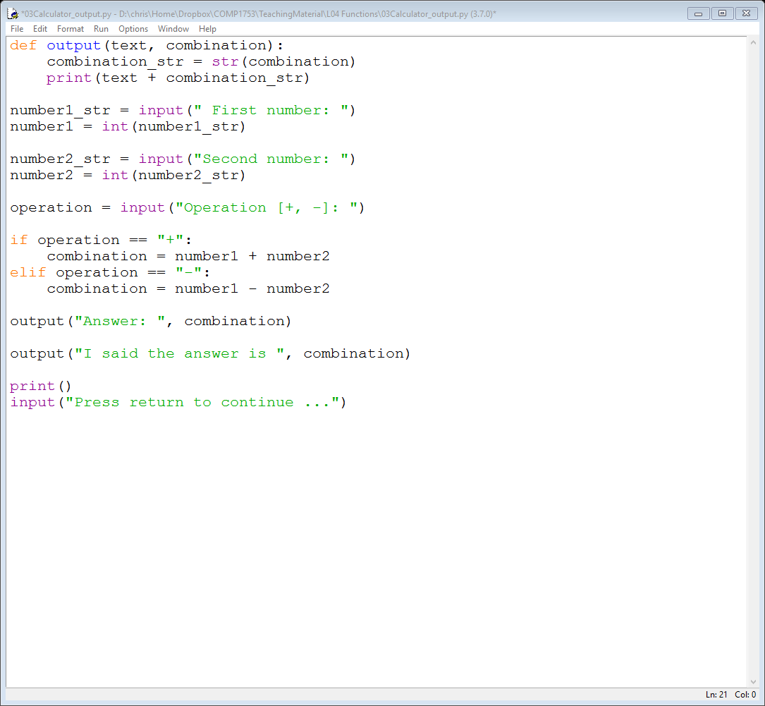
Declaring functions
We can first hide away some of the output details by declaring (defining) a new function named output()
To declare a function you need
the keyword def
the name of the function followed by a list of its parameters in round brackets
a colon :
the body of the function, indented
we will discuss in a minute

Slide 19
03Calculator_output
Our new output() function looks like this
It is given two variables to deal with text and combination
It converts combination into a string and then prints it out, appended to text

Slide 20
03Calculator_output
Now to print the output we can just use
Or we could use
the output function doesn’t care what text it is given, it just gets on with the job

Slide 21
03Calculator_output
The code as a whole now looks like
output is declared (defined) here
output is invoked (used) here …
… and here

Slide 22
Functions flow of control
Like conditionals, functions change the flow of control through the program
statement
statements in the function may be used many times as the program runs
function call
statement
statement
statement
function call
statement
statement

Slide 23
Functions – file structure
In Python, functions are written (defined) at the top of the program
The main part of the program is written after the functions are defined
function(s) – there may be several
the main part of the program

Slide 24
Functions – execution
When you run a program, the execution of the code starts at the top of the main program
after any function(s) are defined
this is usually not the top of the file!
The execution proceeds down the file, one statement after another
It then drops down into the functions as they are invoked
And returns back to the main program once the function has been executed
notice that in this case the code inside the function has been executed twice

Slide 25
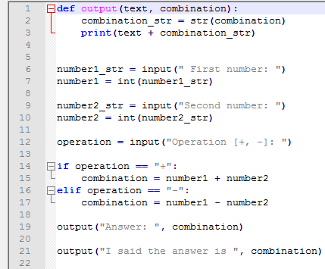
Quick Check (1)
On what line does the execution of the program start
answer: line 6
In what order are the statements executed (what are the line numbers)
answer: 6, 7, 9, 10, 12, 14, (15 or 16, 17), 19, 2, 3, 21, 2, 3

Slide 26
Arguments
The following line invokes or calls the function output()
It also passes some information to the function, namely
the string "Answer: "
the variable combination
These are known as arguments
nothing to do with a disagreement!
A function can have several arguments or sometimes none at all
see later examples

Slide 27
Parameters
The information passed to a function is known as its parameters
In this case there are 2 parameters, one named text and one named combination, like the previous slide
but the names don’t need to match – see later
A function can have several parameters or sometimes none at all
The words “argument” and “parameter” are often used interchangeably

Slide 28
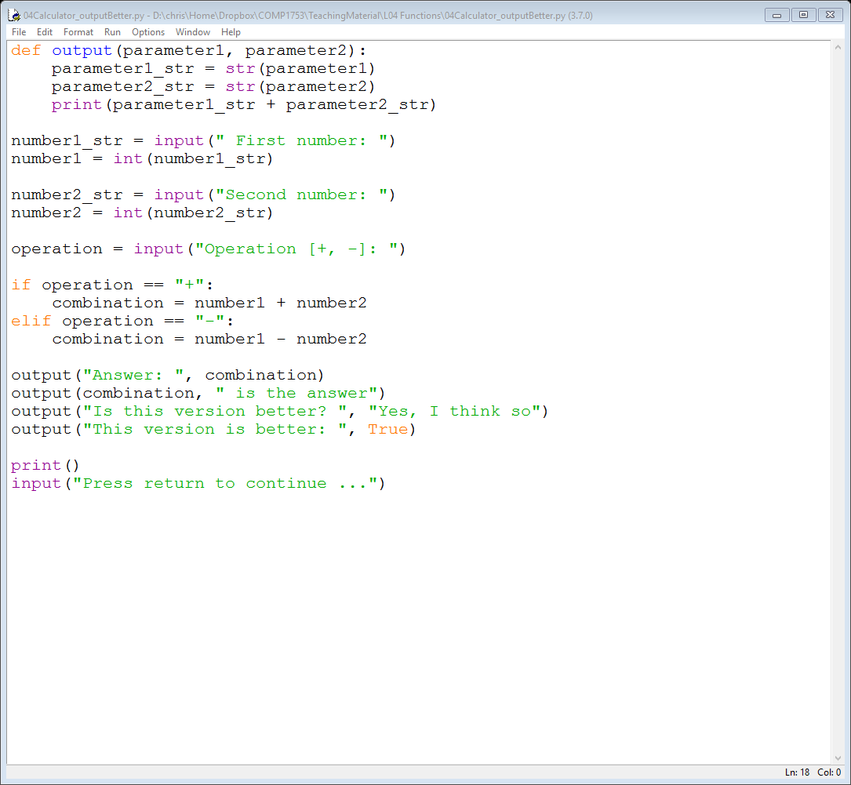
04Calculator_outputBetter
The first version of output() isn’t ideal as the programmer has to remember that the first variable is a string and the second is a number
We can improve on this with a better version
Now the output function converts both parameters to strings
even if they are already a string!

Slide 29
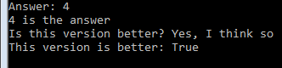
04Calculator_outputBetter
This makes our output function much more flexible
now it works with …
a string and an integer
an integer and a string
two strings
a string and a boolean

Slide 30
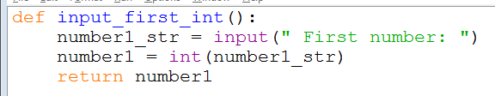
05Calculator_input12
We can also hide away details of the input
input_first_int() is a function which
prompts the user for the first number
converts it from a string into an integer
returns the integer back to the invoking code
input_second_int()does the same for the second number

Slide 31

Invoking a function which returns a value
Now the invoking code just looks like this
Since input_first_int() and input_second_int() are both returning a value we need to store it somewhere
i.e. in the variables number1 and number2

Slide 32
output() vs input_*_int()
output()
has two parameters
doesn’t return a value to the code it is invoked from
so information is passed in, but not out
input_first_int() & input_second_int()
have no parameters
return a value to the invoking code
so information is passed out, but not in
Because of what is passed back to the invoking code, in some languages, output() would be known as a subroutine and input_*_int() would be known as functions
or they might be referred to as methods
but in Python everything is a function

Slide 33

Duplication
In fact 05Calculator_input12 is over complicated
input_first_int() and input_second_int() do exactly the same thing … but with a different prompt
If we pass in the prompt text in as a parameter we only need one function!

Slide 34
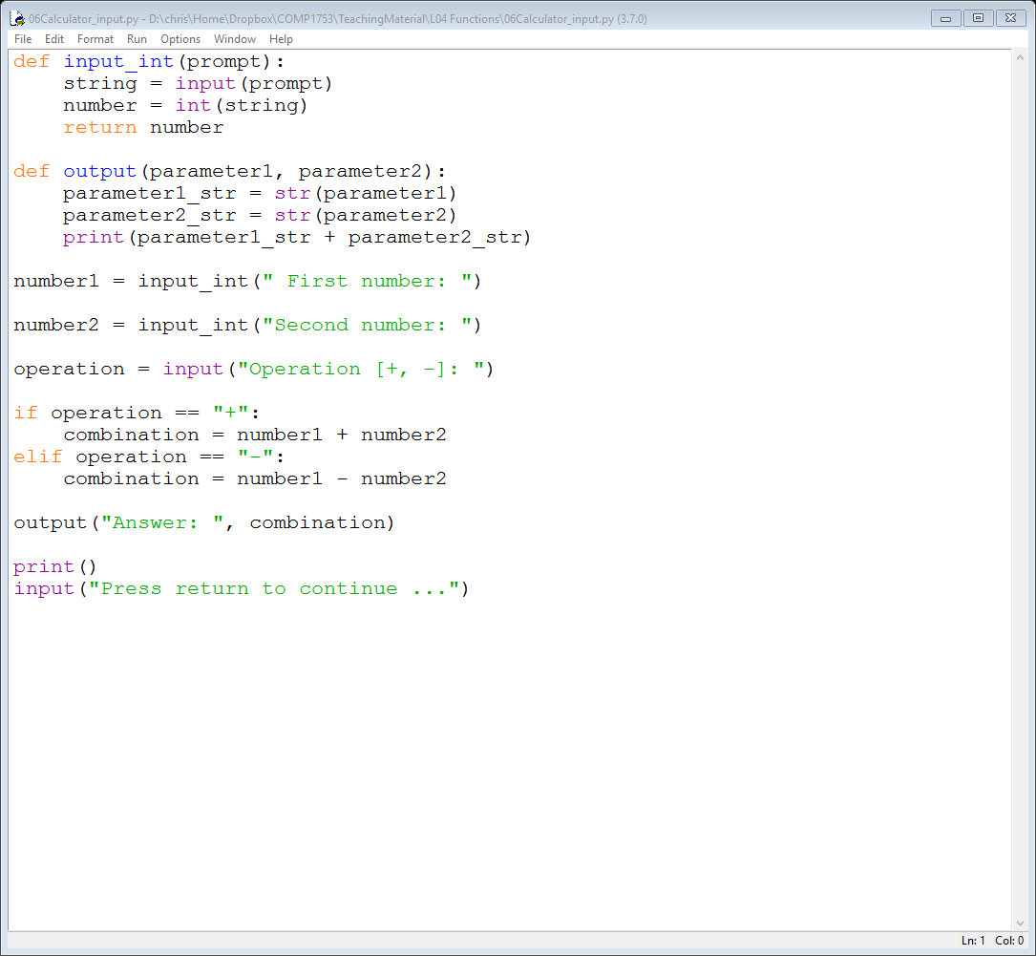
06Calculator_input
The input_int() function just prompts the user for a value which is converted to an integer and returned
The invoking code is now nice and simple

Slide 35
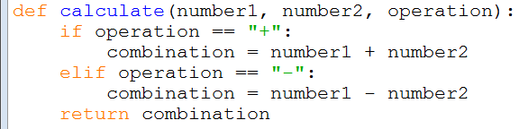

07Calculator_calculate
We can even hide away the details of the calculation in a function
The invoking line is

Slide 36
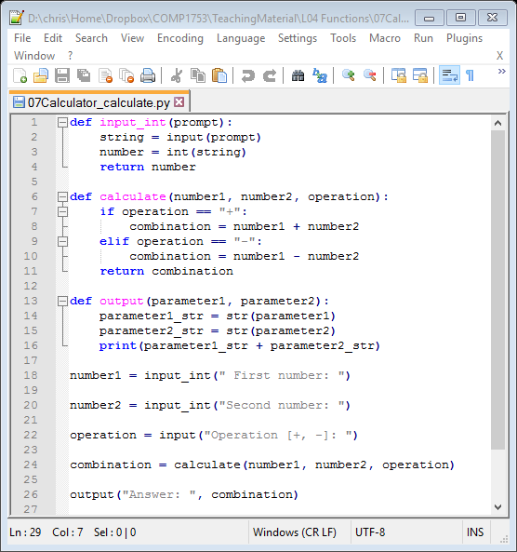
Quick Check (2)
On which line is calculate() invoked?
answer: line 24
On which lines is calculate() declared?
answer: lines 6-11
How many parameters does calculate() have?
answer: 3 (number1, number2 & operation)
What does calculate() return?
answer: the value stored in the variable combination (and not the variable itself)

Slide 37
Quick Check (3)
On what line does the execution of the program start
answer: line 18
In what order are the statements executed (what are the line numbers)
answer: 18, 2, 3, 4, 20, 2, 3, 4, 22, 24, 7, (8 or 9, 10), 11, 26, 14, 15, 16

Slide 38
Using a function as a parameter
There is one further change we can make
Unlike some programming languages, Python allows us to use a function as a parameter for another function
So currently we have an input_int() function which returns an integer
But instead we can just have an input_and_convert() function where …
we give it the conversion function
we get back whatever data-type we want

Slide 39
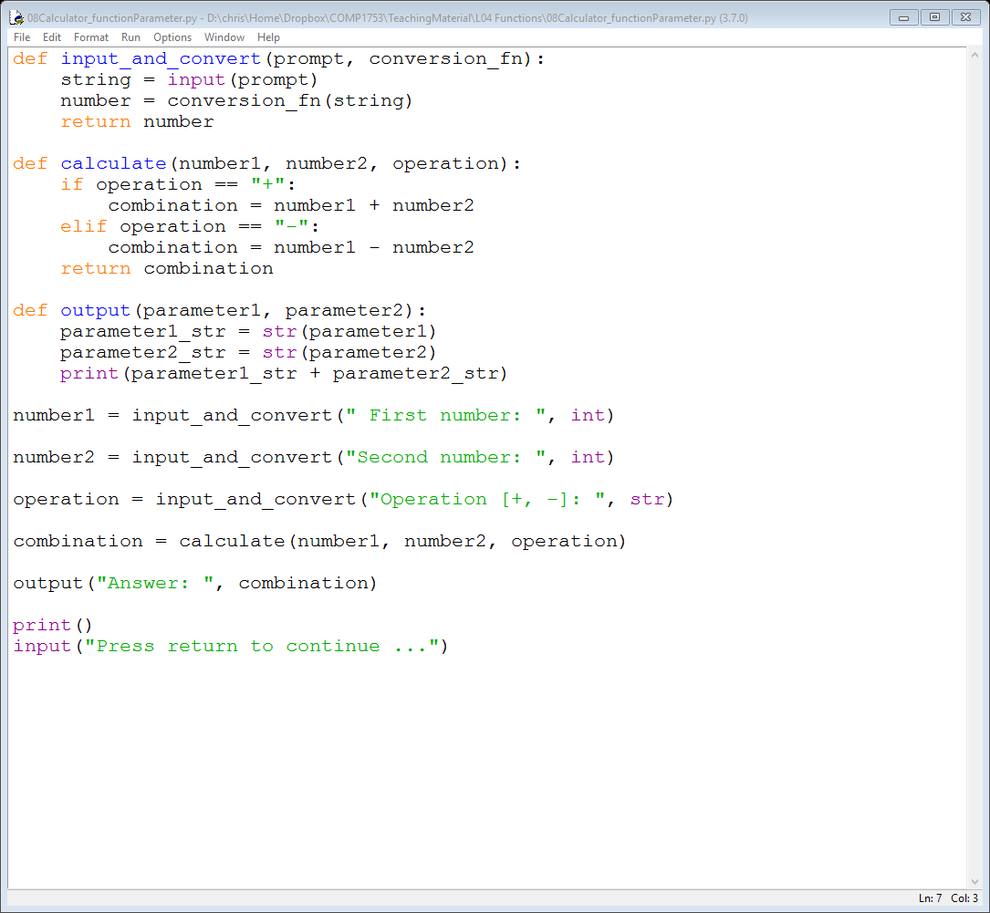
08Calculator_inputAll
The new function looks like this
Now we can invoke it to get different things back (e.g. integers and strings)

Slide 40
Problems with functions
Beginner programmers often have problems when implementing functions
This can result in
syntax errors – the program doesn’t run
run-time errors – the program starts running but crashes halfway through
bugs – the code doesn’t run as expected or gives the wrong output
anomalies – the code works fine, but doesn’t make sense

Slide 41
Syntax errors
Simple syntax errors include
forgetting the def keyword
forgetting the round brackets
forgetting the colon :
not indenting the body of the function
Any of these will prevent the program from running at all
We will now look at several examples illustrating other things that can go wrong

Slide 42
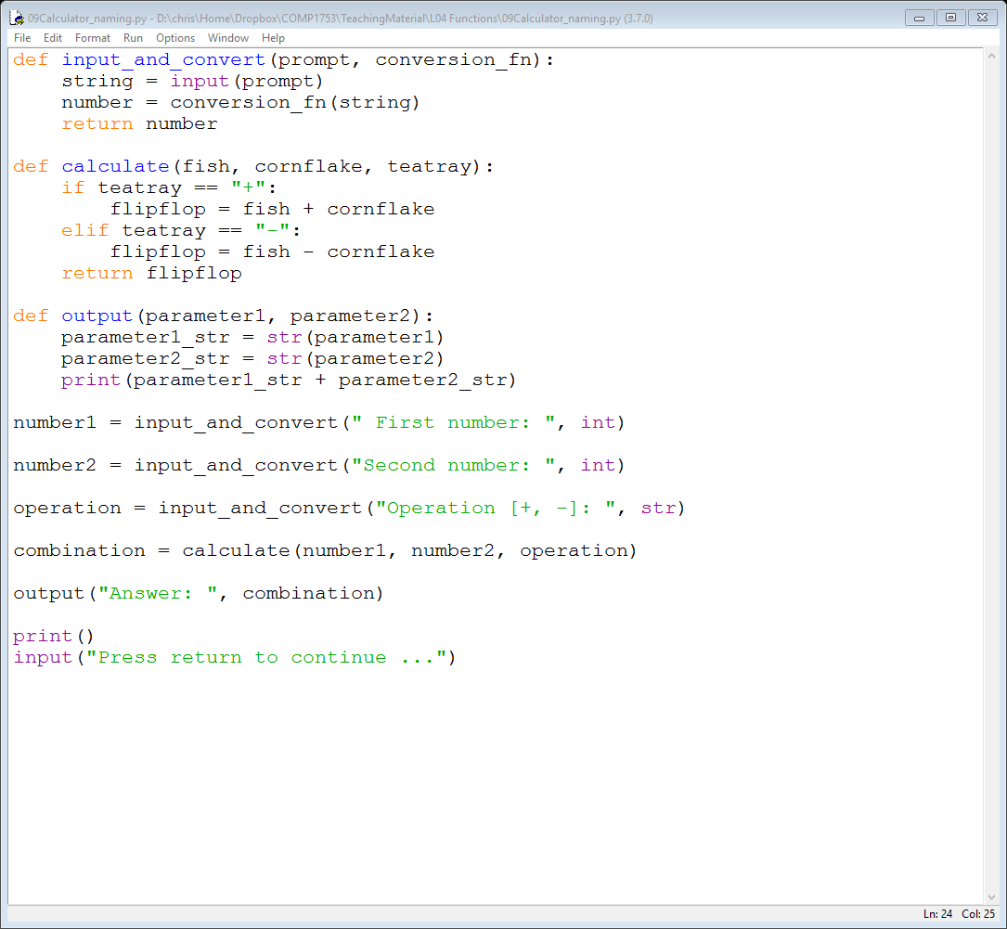
09Calculator_naming
Firstly, the variable names in the invoking code (i.e. the names of the arguments) don’t need to match those in the function (i.e. the names of the parameters)
But they should make sense!
this is not a bug or an error … but it makes the code really hard to read

Slide 43
Scope
In fact the variables used inside the function are completely different variables to the variables used in the invoking code
they just store a copy of the value in the invoking code
For this reason you can’t get a function to change a variable you pass in
it just changes a copy of the variable

Slide 44
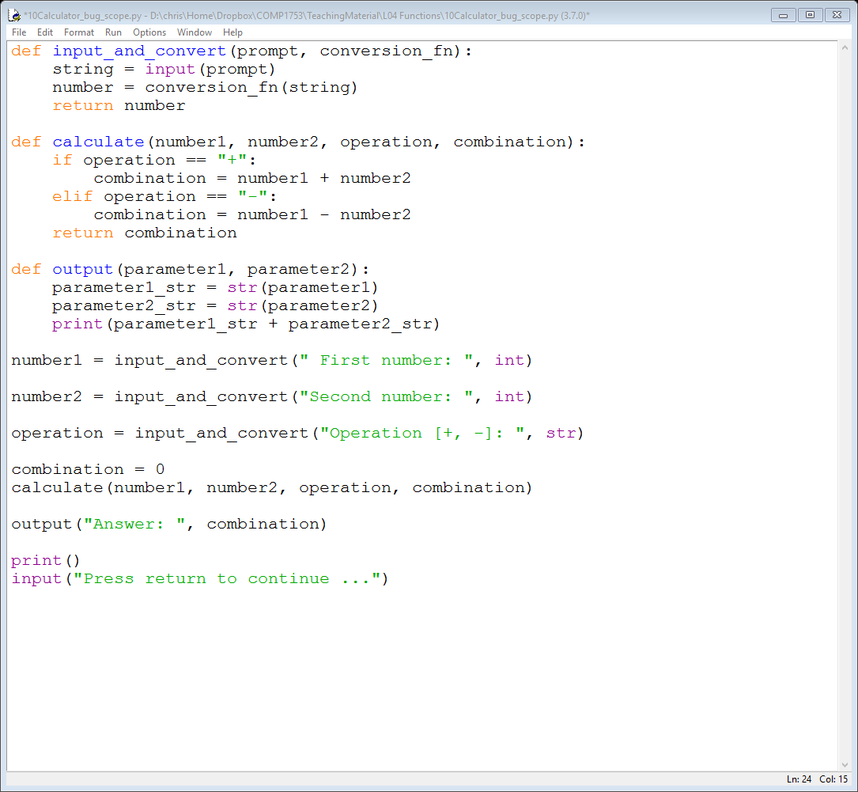
10Calculator_bug_scope
Example 10 illustrates this – the variable combination is passed to calculate()
calculate() modifies a variable called combination but it is a different variable

Slide 45
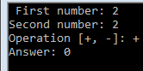
Scope
So the variable in the invoking code is unchanged and the output is wrong – a bug
The remaining examples are simpler …
e.g. mismatched parameters & arguments
usually result in a run-time error – the program will run but crashes halfway through

Slide 46
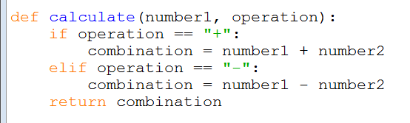
11Calculator_parameters
In example 11 the programmer has only declared two parameters for the function but the function needs three
This program will run but will crash when trying to do the calculation
number2 is not defined

Slide 47
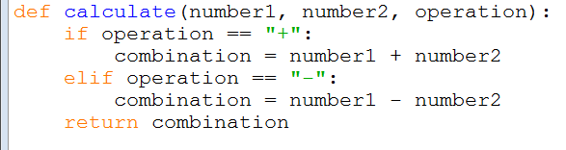

12Calculator_arguments1
In example 12 the programmer has declared three parameters (as required) but is trying to pass in four arguments
This program will run but will crash when trying to do the calculation
no matching parameter

Slide 48
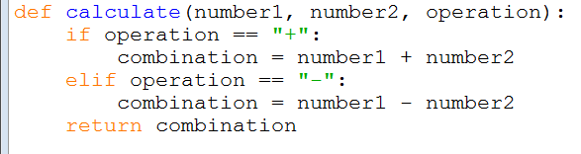
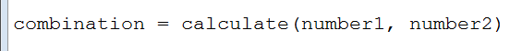
13Calculator_arguments2
In example 13 the programmer has declared three parameters but is trying to pass in two arguments
This program will run but will crash when trying to do the calculation
no matching argument

Slide 49
Defaults
In fact it is possible to create functions that can be invoked with different numbers of arguments
To do this we just need to define a default value for when an parameter is not passed in

Slide 50
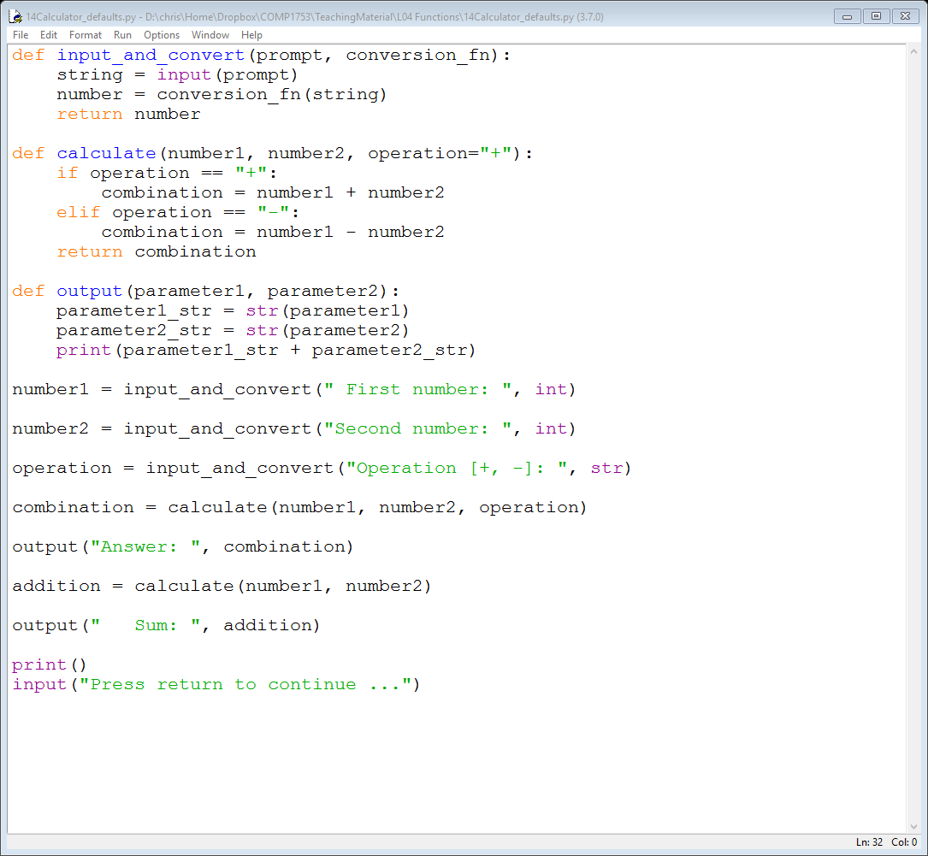
14Calculator_defaults
In this version, if the operation parameter is not passed in to the function calculate(), it defaults to "+"

Slide 51
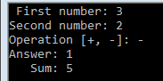
14Calculator_defaults
Now we can call calculate()in two different ways
three arguments
two arguments

Slide 52
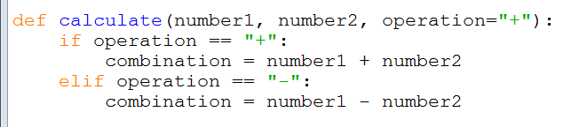

No return statement (Example 15)
Finally, in example 15 the programmer has forgotten the return statement
This will run without crashing but will not give you the answer you expect
nothing returned to the invoking code

Slide 53
Summary
This week we have covered functions
declaring
invoking
arguments
parameters
Things sometimes (often) go wrong when you implement functions
looked at several examples
keyword: def
function_name()
passed from the invoking code
passed into the function

